Slide 1
Topology-Varying 3D Shape Creation via Structural Blending
Ibraheem Alhashim (1) | Honghua Li (1)(2) | Kai Xu (2)
Junjie Cao (3) | Rui Ma (1) | Hao Zhang (1)
(1) Simon Fraser University (2) National University of Defense Technology (3) Dalian University of Technology
Notes:
Hello everyone!
Today I’ll present the paper is talking about system for 3D shape creation by continuous blending of different shapes

Slide 2
Outline
Introduction
Overview
Results
Evaluation
Notes:
Today,
First I will discuss motivation of this paper
And then I go on talking about their main method
Final I will show their results and evaluation

Slide 3
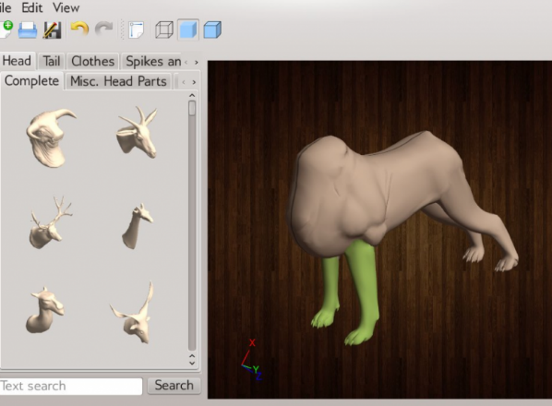
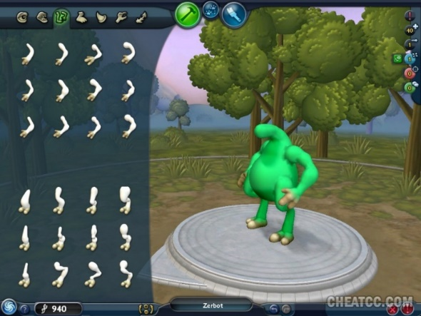
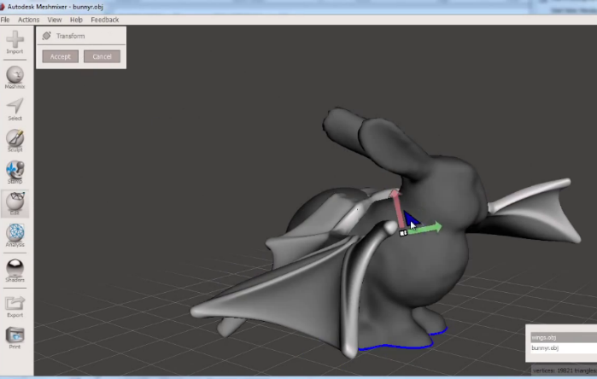
Blending-Based Model Creation
Mixing existing parts for shape creation
[Chaudhuri 11]
[Maxis Spore 08]
[Autodesk Meshmixer 14]
Notes:
Manual mixing of parts from different objects is a well established modeling technique especially for novice users [CLICK!]
There are many recent examples found in both academia and commercial software such as Autodesk’s Meshmixer

Slide 4
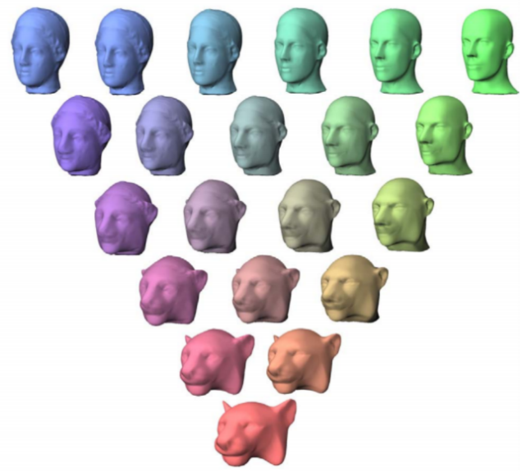
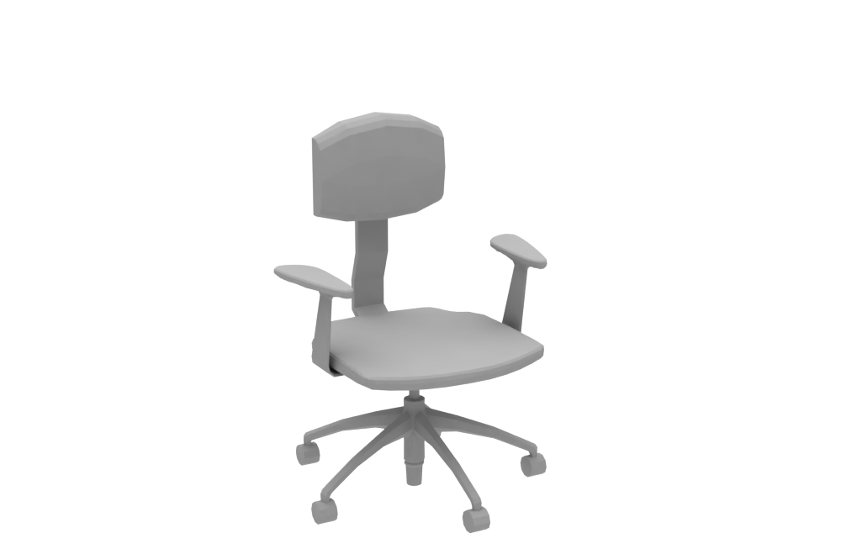
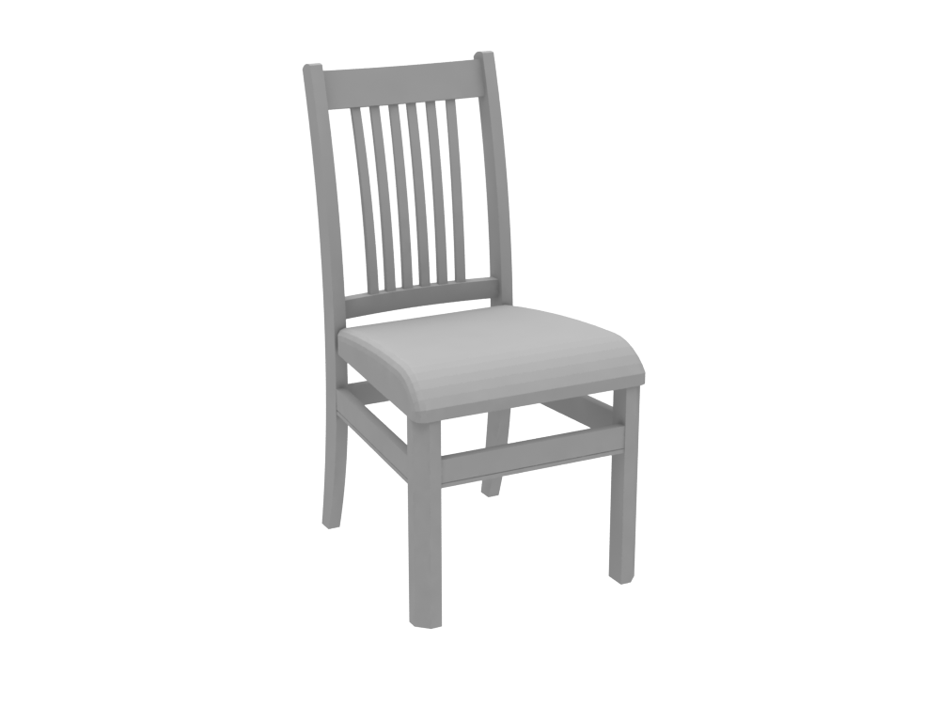
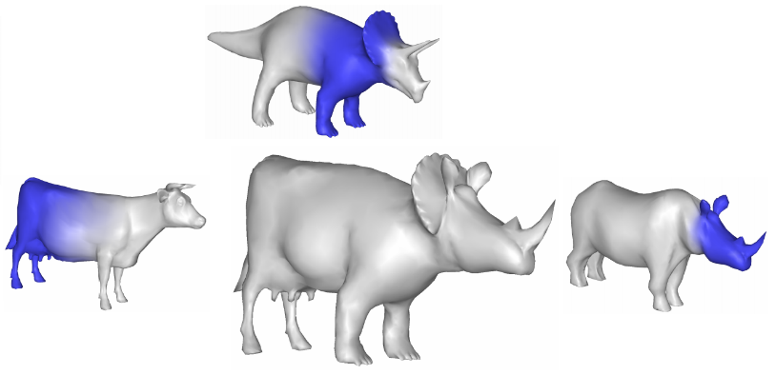
Blending-Based Model Creation
Continuous boundary based shape interpolation
?
[Alexa 02]
[Michikawa 01]
[Kraevoy et al. 04]
Notes:
Rather than pasting parts together [CLICK!]
They utilize continuous shape interpolation for modeling by blending from a pair or more of existing shapes
the main issue however is the requirement for an exact mappings
So [CLICK!] for shapes with large geometric dissimilarity and different structure it is not possible to apply these methods!

Slide 5
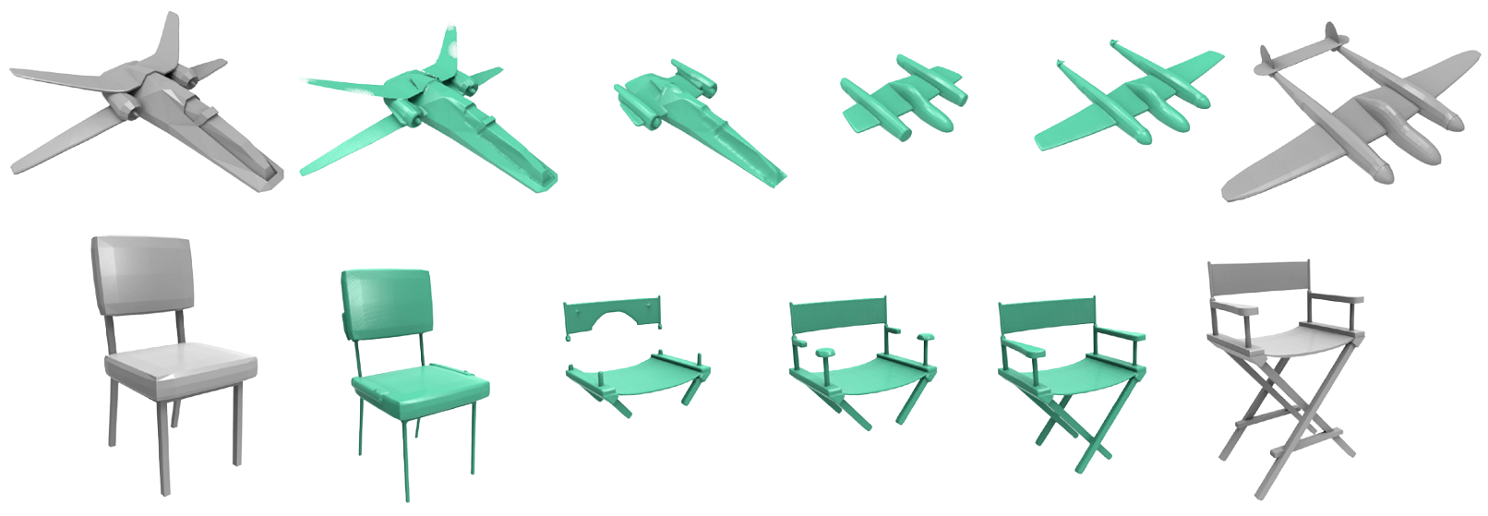
Blending-Based Model Creation
Volumetric based interpolation allows different topology
[Breen & Whitaker 01]
Notes:
an obvious solution would be to look at shape interpolation methods that allow for topological changes between the input pairs [CLICK!]
This volumetric based interpolation is one example
But we can see the in-between are disconnected and distorted aren’t really usable..

Slide 6
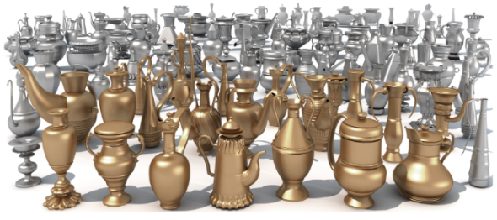
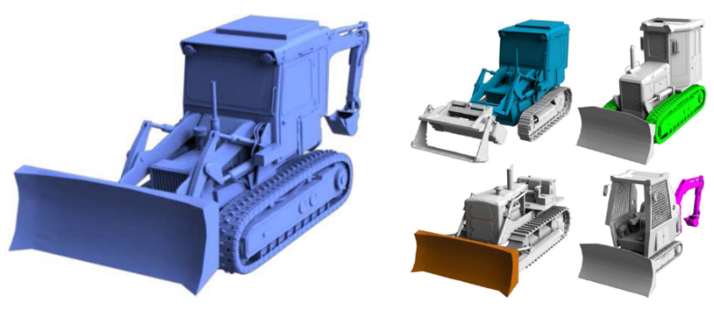
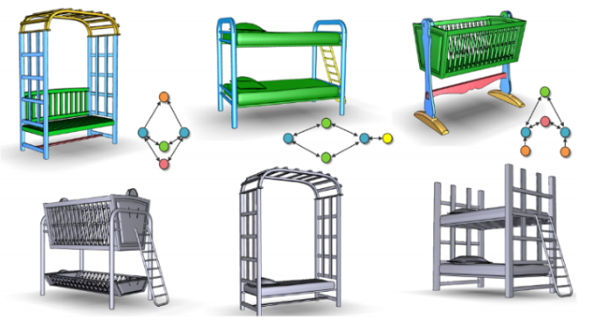
Part Composition
Automatic part replacement and recombination
[Xu et al. 12]
[Jain et al. 12]
[Kalogerakis et al. 12]
[Zheng et al. 13]
Notes:
[CLICK!]
So until now people have been focused on part-based composition for shape modeling [CLICK!]
Many automatic or semi-automatic methods proposed can produce many varieties from shape repositories
They often try to replace compatible parts, where compatibility is determined by geometric or structural properties

Slide 7
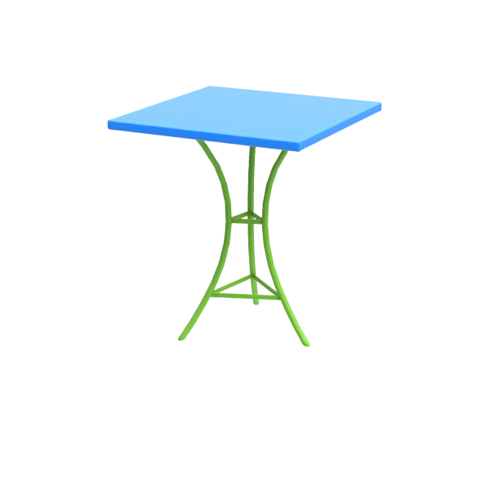
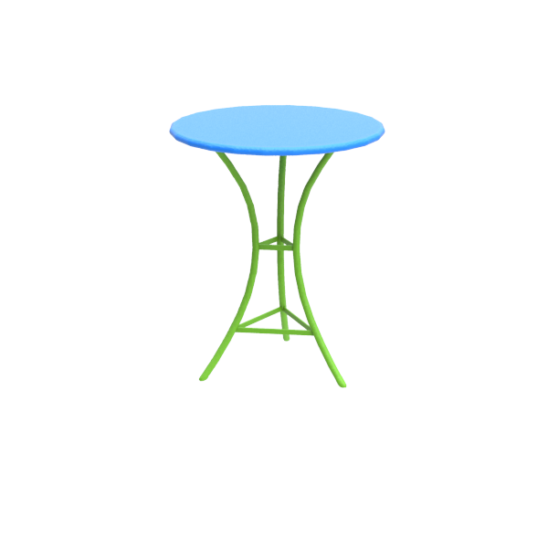
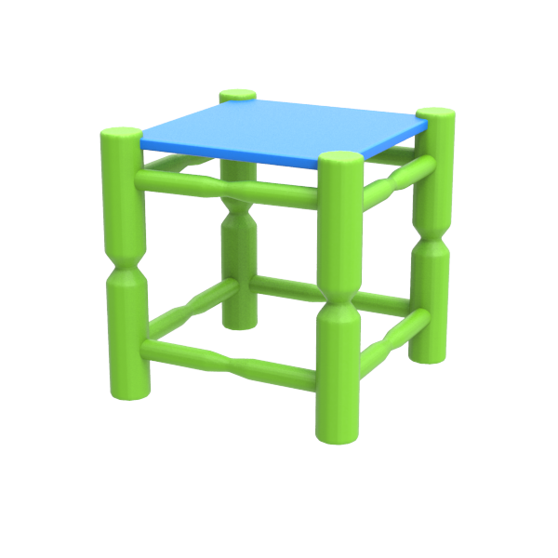
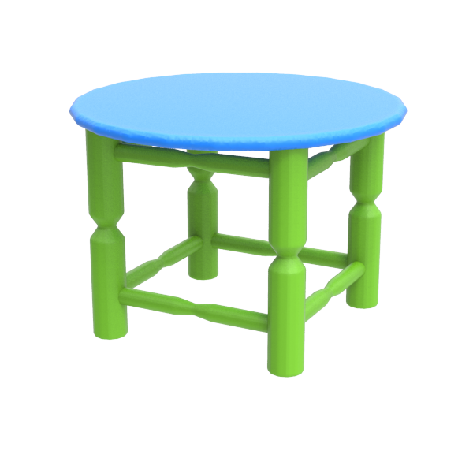
Part Composition
Limited number of possible blends
Notes:
The problem with part composition approaches is that they tend to generate a limited number of possible blends
Here we see a three and four legged tables only generating two new shapes 2X [CLICK!] [CLICK!]
In this work, this paper argue that they can produce even more than that
In fact! They would like a continuous transition from one shape to the other

Slide 8
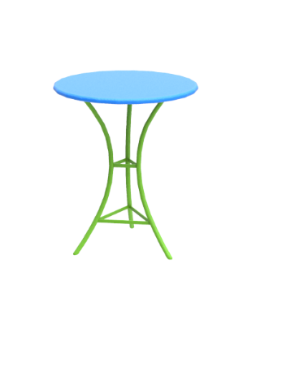
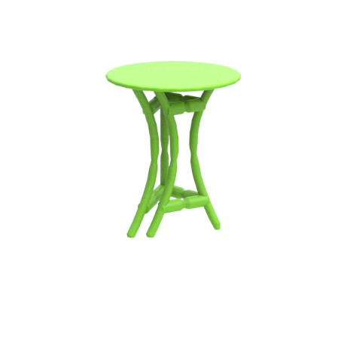
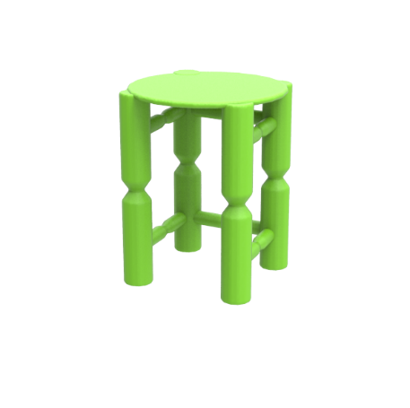
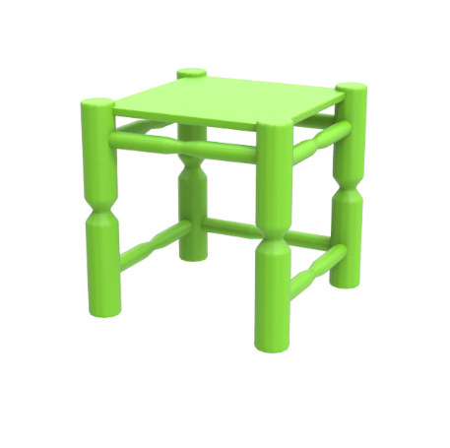
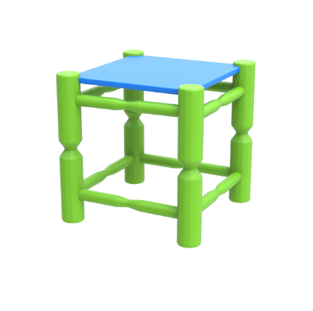
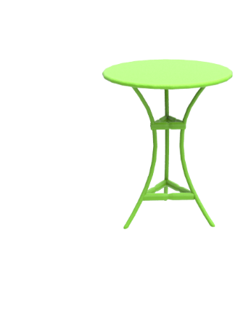
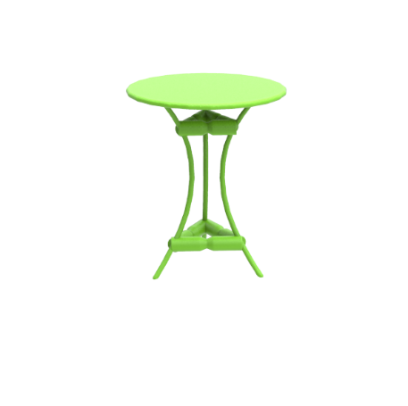
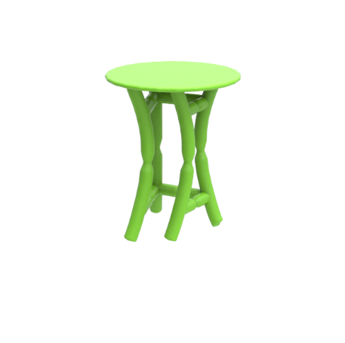
Continuous Shape Blending
Blending on both geometry and topology
Notes:
So they propose the mehod is blending on both geometry and topology [CLICK!]
Notice how the legs are splitting, [CLICK!]
the top morphing, [CLICK!]
and the side bar growing [CLICK!]
The gradual transformation allows us to discover some interesting in-betweens!

Slide 9
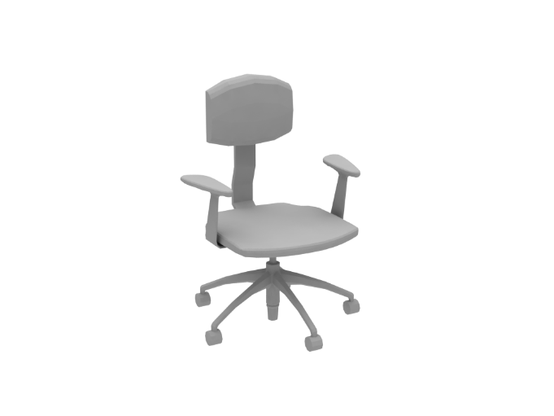
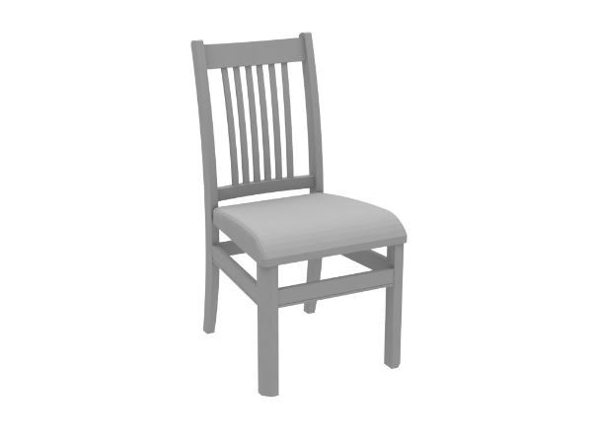
Technical Challenges
Representation level
Surfaces – tracking topology changes hard!
Volumes – difficulty in encoding structure & more involved
Correspondence and interpolation
Parts split, no equivalent parts, geometric dissimilarity…
?
Notes:
I’ll now describe two major technical challenges faced in this problem
The first is the presentation level, tracking topology changes using surface representation is very difficult!
As we saw, volumes are able to do so but we are faced with challenge of preserving the integrity of the shape
The second challenge is deciding on the part correspondence between parts of very different shapes
We need to consider that parts might split, have no equivalent, and are very different in proportions

Slide 10
Overview
Notes:
It is overview of the shape blending algorithm.
First, input a source and target shape, then convert each into a skeletal curve-sheet representation.
Second, is augmented graph to accommodate missing part and one-to-many correspondences.
Third, blending generates multiple path of in-betweens.
Final, output the results using implasubility filter.

Slide 11
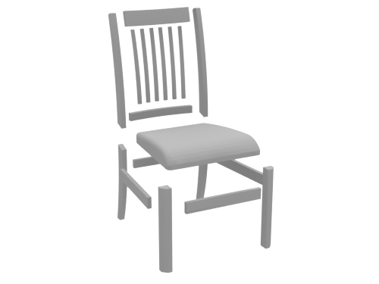
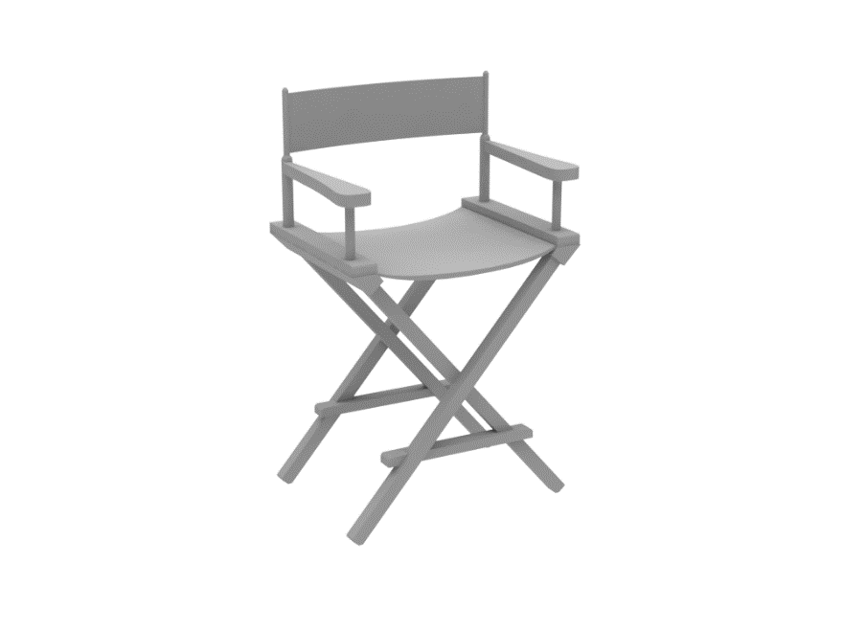
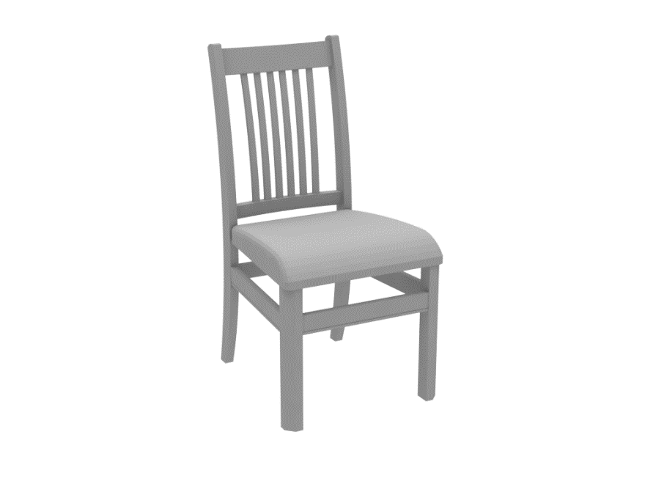
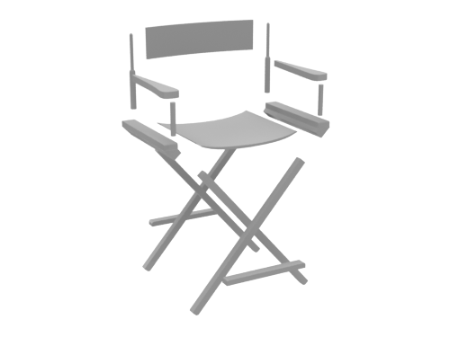
Overview
Notes:
So we took a shot at it and came up with this work as a first solution
Preprocess: segmentation, skeleton extraction, and possibly modifying the connected parts.
First we will assume that the inputs are composed of segmented parts

Slide 12
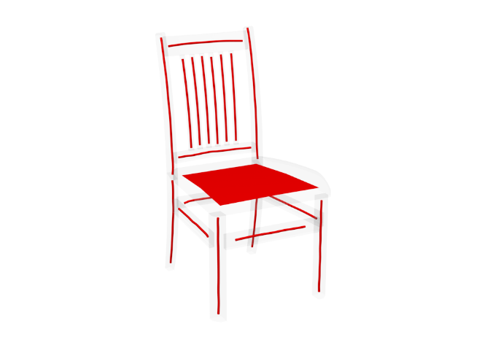
Overview
Curve + sheet part abstractions – [Tagliasacchi 12]
Topological changes are more straightforward
Notes:
The parts are abstracted by fitted curves and sheets resulting from skeletonization
These abstractions have the advantage of
Simplicity to work with as opposed to the original surfaces
Simplify carrying out topological changes
Simplify the discovery and encoding of part relations

Slide 13
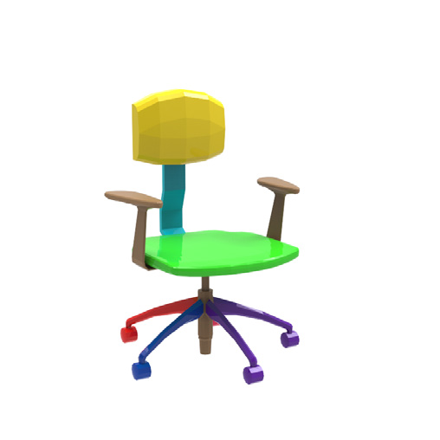
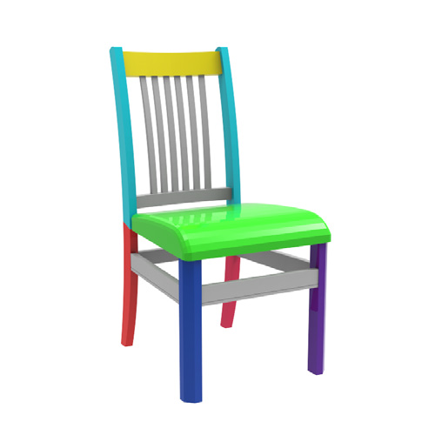
Overview
Part correspondences
Allow parts to correspond to many or even no other part
Part blending is structure-aware and continuous
none-to-one
many-to-one
one-to-one
Notes:
For tackling the second challenge [CLICK!]
we allow different types of part correspondences
defining part correspondences. We allow three types of correspondences:
one-to-one shown here for the backs
one-to-many as seen here for the vertical bars in blue
and for parts with no equivalent we define one-to-none or in this case many-to-none for the two armrest parts
And so parts may or may not have one or more corresponding parts [CLICK!]
[CLICK!] Plus, we apply all our per-part blending operations in a continuous manner. This lets us explore variability while helping preserve part relations during the entire blend

Slide 14
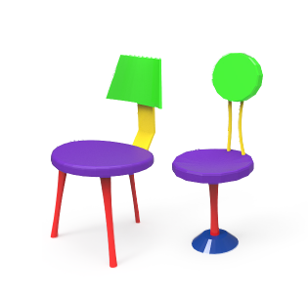
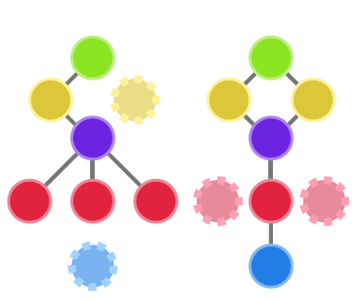
Overview
Structural graphs
Notes:
Each shapes can get a structural graph
The node represent a curve or a sheet
The edge represent relation of connection

Slide 15
Overview
Augmented graphs
Red line: {split, original}
Blue line: {null, original}
Notes:
兩個模型的part有一對一,一對多,一對無三種情況
增強結構圖是為了讓兩個不對應的結構圖可以變的對應
為了讓兩個結構圖能夠對應,所以缺少的node就會被補上
把點補上之後,也要補齊他們線的連接關係
紅色表示{split, original}原本為一個可以分裂來達到對應
藍色表示{null, original}原本沒有,需要新加上去才能對應

Slide 16
Overview
Blending Operations
Each part is assigned an operation
Continuous transformation from source to target
MORPH
GROW
SHRINK
SPLIT
MERGE
Notes:
The blending process is carried out as a set of blending operations
Each part is assigned a blending operation
Continuous transformation from source to target
They are related to the assigned correspondences
The operations include : morphing, growing, shrinking, splitting, and merging

Slide 17
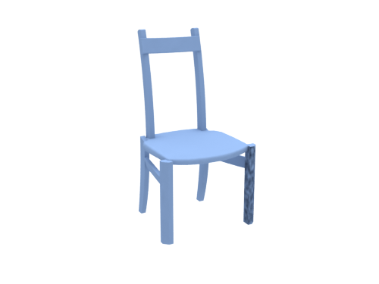
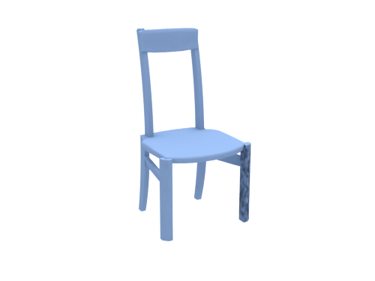
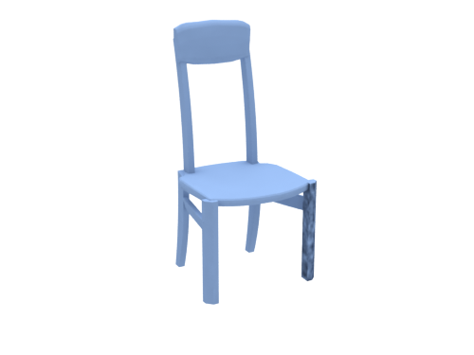
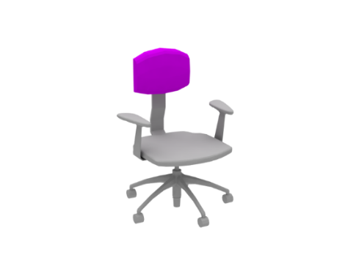
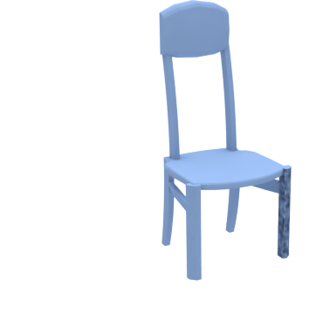
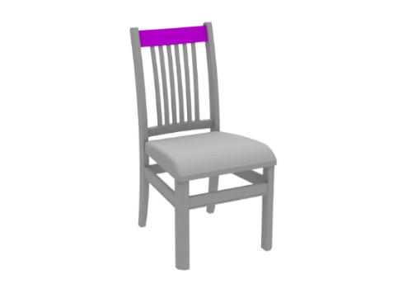
Overview
One-to-one: morphing
MORPH
GROW
SHRINK
SPLIT
MERGE
Notes:
The blending operations [CLICK!] include part morphing, [CLICK!] for one-to-one correspondences

Slide 18
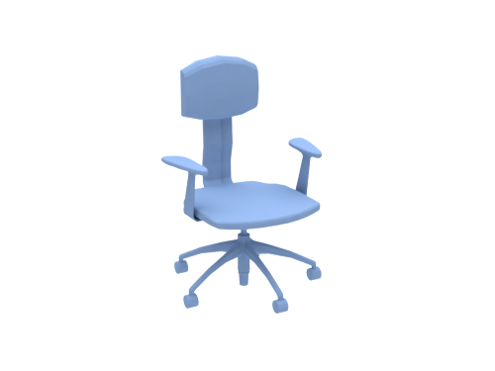
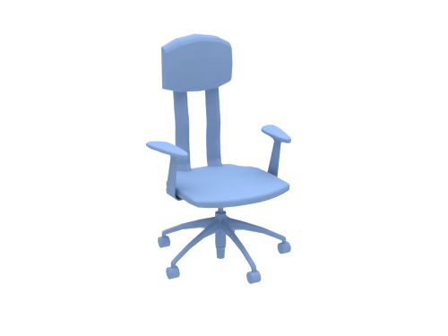
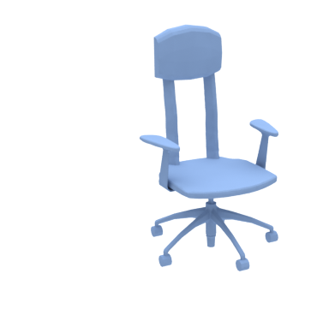
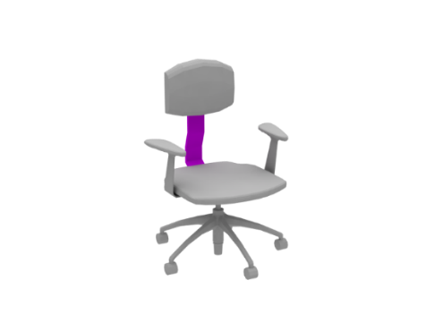
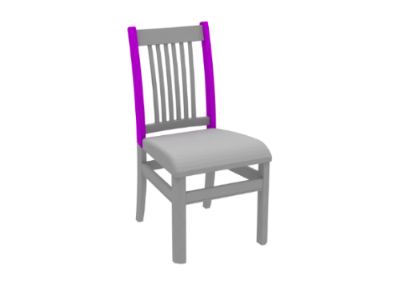
Overview
One-to-many: splitting / merging
MORPH
GROW
SHRINK
SPLIT
MERGE
Notes:
Part splitting or merging [CLICK!] for one-to-many correspondences, applied here to the back vertical bars

Slide 19
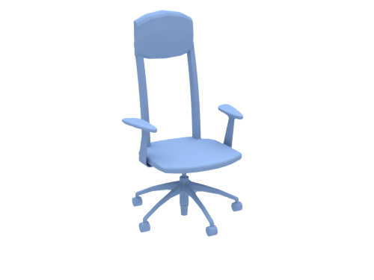
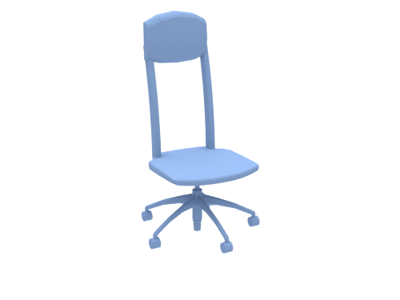
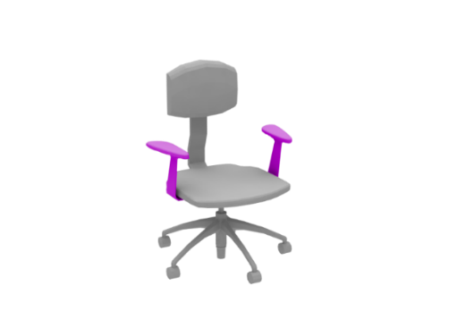
Overview
One-to-none: shrinking / growing
MORPH
GROW
SHRINK
SPLIT
MERGE
Notes:
and part growing or shrinking for parts on one shape that do not have a compatible equivalent on the other

Slide 20
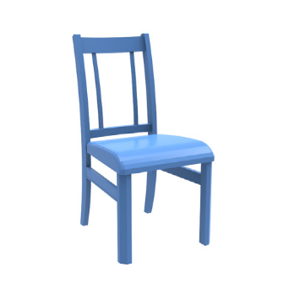
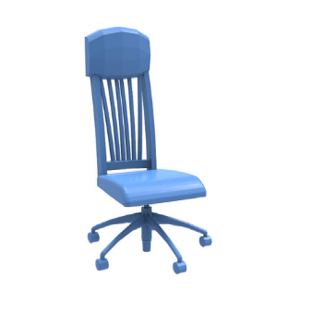
Overview
Blending path – a permutation of the set of blending operations
Variability in blending by reordering
MORPH
GROW
SPLIT
SHRINK
MERGE
SHRINK
MERGE
MORPH
SPLIT
GROW
MERGE
GROW
SHRINK
SPLIT
MORPH
Notes:
A blending path is a permutation of the set of blending operations assigned
The variability of the generated paths is a result of the reordering of the blending operations

Slide 21
Overview
topology changes!!
…
…
…
…
…
…
…
…
…
…
…
…
novel shapes!
Notes:
Continuous shape blending
Following these main ideas, our solution can generate a large number of continuous blending transformations
This results in interesting [CLICK!] topology changes and helps users discover [CLICK!] novel shapes as seen here
--------------------------------------------------------------------
With the defined correspondences we now generate many sets of blending paths that transform the different parts of one shape to the other
Which is done by changing the ordering of the defined blending operations on each part

Slide 22
Overview
Filter out obviously bad results
Global reflection symmetry
Part group symmetry
Part connectivity
Notes:
the input pairs do not necessarily share the general structure, so it is likely that we produce implausible shapes
And so we apply a filtering that is based on measuring the extent of preserved global and local relations, including symmetry relations and part contact
This filtering is purely geometrical, it does not guarantee good plausibility nor it is useful to discover interesting new shapes
These things are still limited to human judgment

Slide 23
Overview
Notes:
The last step is a basic filtering step [CLICK!] that discards clearly implausible results

Slide 24
Results
Notes:
We’ve tested our method on a set of 110 man-made objects with rich topological and structural variation
We can see some of the generated in-betweens are similar to ones generated via part replacement, as in some of robot models
While other shapes are simply not possible without the blending of both the geometry and connectivity of the parts as seen in these beds

Slide 25
Results
Notes:
Here we see blending of a pair of bench models and desk lamps

Slide 26
Results
Notes:
Here are models that are not related to chairs!
I’ve had some feedback about how are method might be useful in the kitbashing community

Slide 27
Results
Structure preservation
Symmetry relations, local and global
Part contacts
Notes:
Each path executes the blending operations while keeping the original structural relations in mind
These relations include symmetry both local and global, and part contacts
We can see that the side parts of the beds are changing together which preserves global symmetry

Slide 28
Results
Recursive blending
Notes:
[CLICK!] We’ve also tried to apply our shape blending recursively [CLICK!]
One avenue for future work is to try to apply blending across a larger collection of shapes together rather than on shape pairs

Slide 29
Evaluation
Part replacement vs. continuous blending
[this paper] [set evolution]
Notes:
[CLICK!] It’s tough to fairly evaluate our approach with existing discrete shape creation by part recombination [CLICK!]
So what we did is try to evaluate the quality and variability of the produced outputs, and here is an example that shows that continuous blending can generate a bit more variable and natural in-betweens

Slide 30
Evaluation
Volumetric morphing vs. continuous blending
[this paper] [volume morphing]
Notes:
And coming back to volumetric approaches, we noted how results can be broken and parts distorted when blending structured objects
We can see how our blending, shown in blue, produces more plausible results

Slide 31
Evaluation
Volumetric morphing vs. continuous blending
[this paper] [volume morphing]
Notes:
Here is another examples..

Slide 32
Conclusion
3D model creation via continuous shape blending
First to consider topology + geometry with a structure-aware representation
Developed an intuitive tool to help explore continuous space
Notes:
To conclude,
We have presented a 3D model creation system based on continuous shape blending
First to consider topology and geometry by utilizing a structure-aware representation
To better help users explore the space of possible in-betweens, we’ve developed an intuitive tool that efficiently generates these continuous blending path

Slide 33
Conclusion
3D model creation via continuous shape blending
First to consider topology + geometry with a structure-aware representation
Developed an intuitive tool to help explore continuous space
Previous – Rigid transformation of parts
Current – Interpolation of geometry + structure + part connectivity
Notes:
To summarize our work,
While previous works only apply rigid transformations in part composition
We’ve shown that interpolation of ‘geometry’, ‘structure’, and ‘part connectivity’ generates much more variability!

